Slide 1
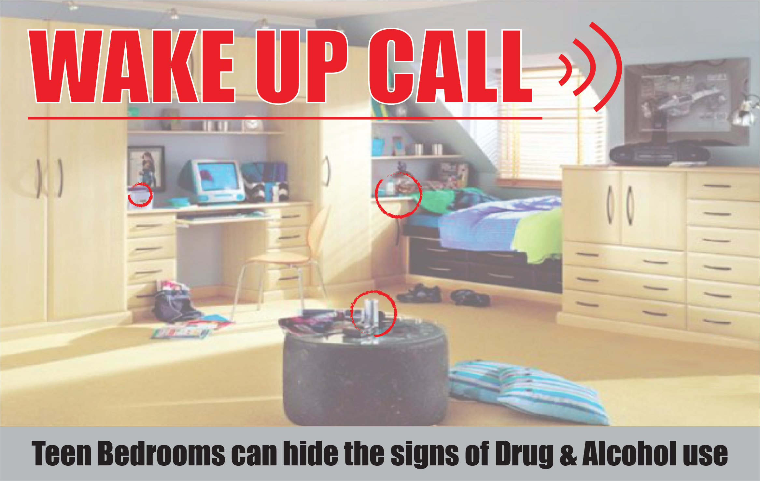
Wake Up Call
Date High School Address,
City, State Zip
Time
Wake Up Call -life-sized exhibit of a teen’s bedroom that identifies spots where teens may hide drugs, household items that can be used as drug paraphernalia and ways teens try to cover up drug and alcohol use.
Wake Up Call
Date High School Address,
City, State Zip
Time
Wake Up Call -life-sized exhibit of a teen’s bedroom that identifies spots where teens may hide drugs, household items that can be used as drug paraphernalia and ways teens try to cover up drug and alcohol use.

